Slide 1
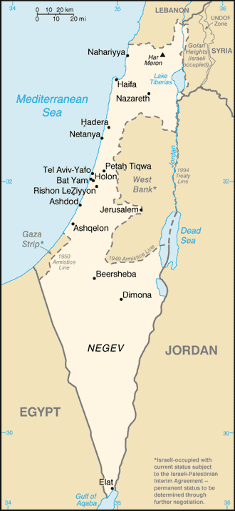

Slide 2
Begging the Questions?
John1:1-14
The Question of Creation
The Question of Darkness
The Question of Christ

Slide 3
Begging the Questions?
John1:1-14
That All, which always is All every where,
Which cannot sin, and yet all sins must bear,
Which cannot die, yet cannot choose but die,
Lo, faithful Virgin, yields himself to lie
In prison, in thy womb …
… Immensity cloistered in thy dear womb

